Slide 1
Identify trips and tripmode in PALMS
Trips
PALMS uses a state-based method for classifying points as stationary, moving, and paused states
This method requires that specific criteria are met before changing from one state to another
Consecutive points classified as ‘moving’ are marked as a trip
Tripmode
For each trip, tripmode is classified based on average speed during the trip

Slide 2
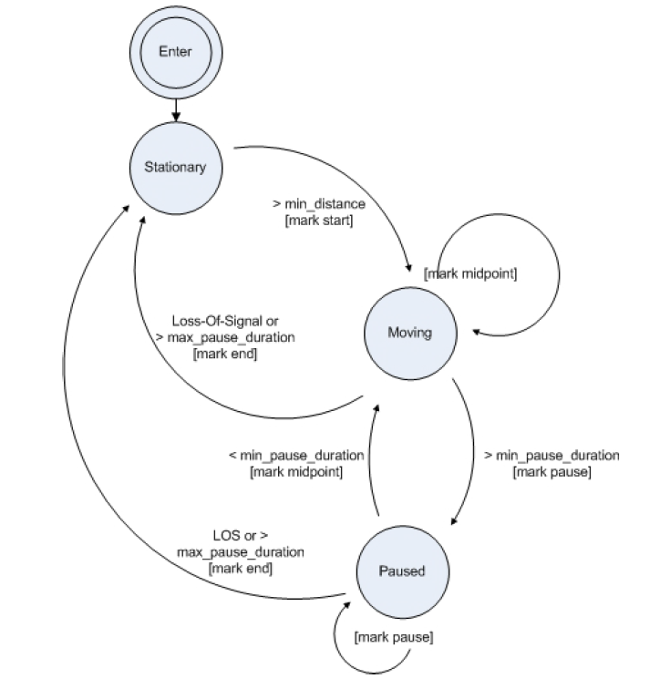

Slide 3
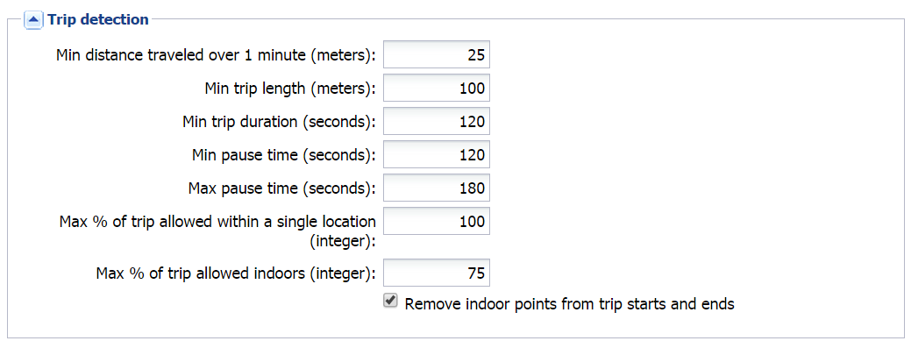
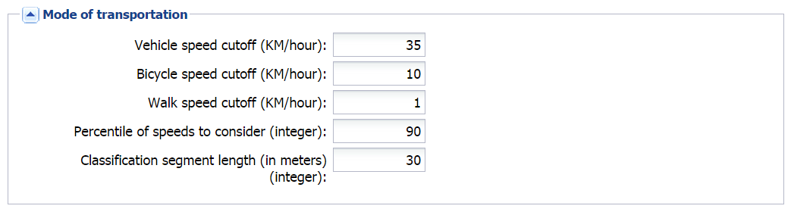

Slide 4
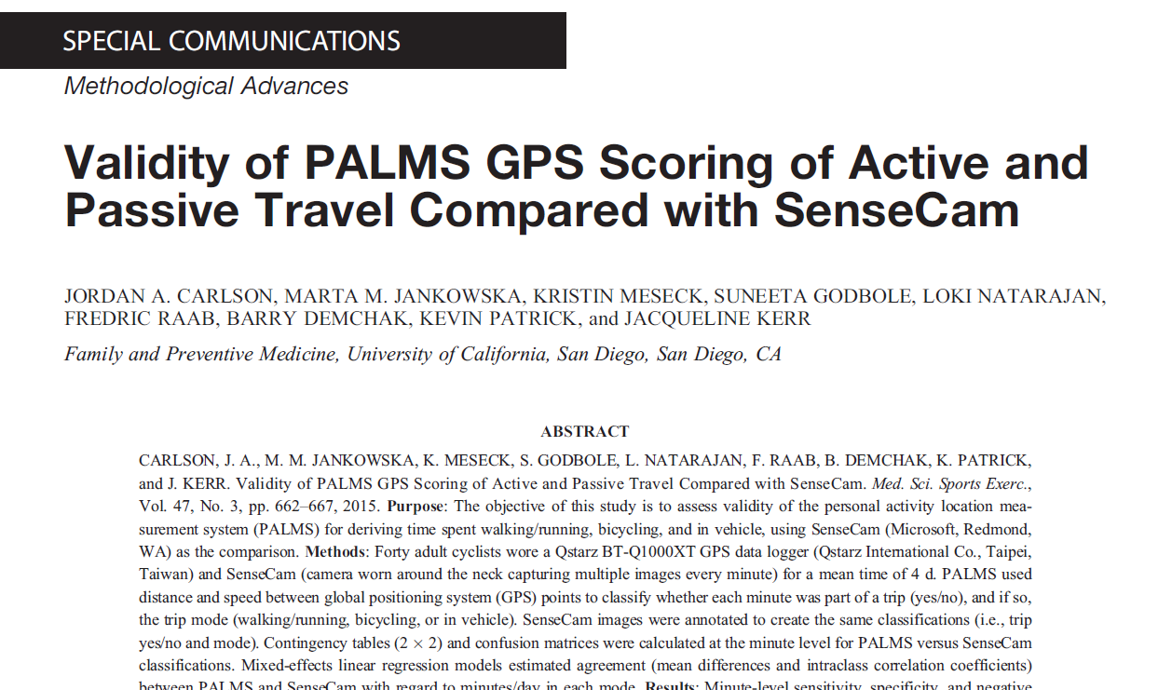
Minute-level sensitivity, specificity, and negative predictive value were >88%, and positive predictive value was >75% for non–mode-specific trip detection

Slide 5
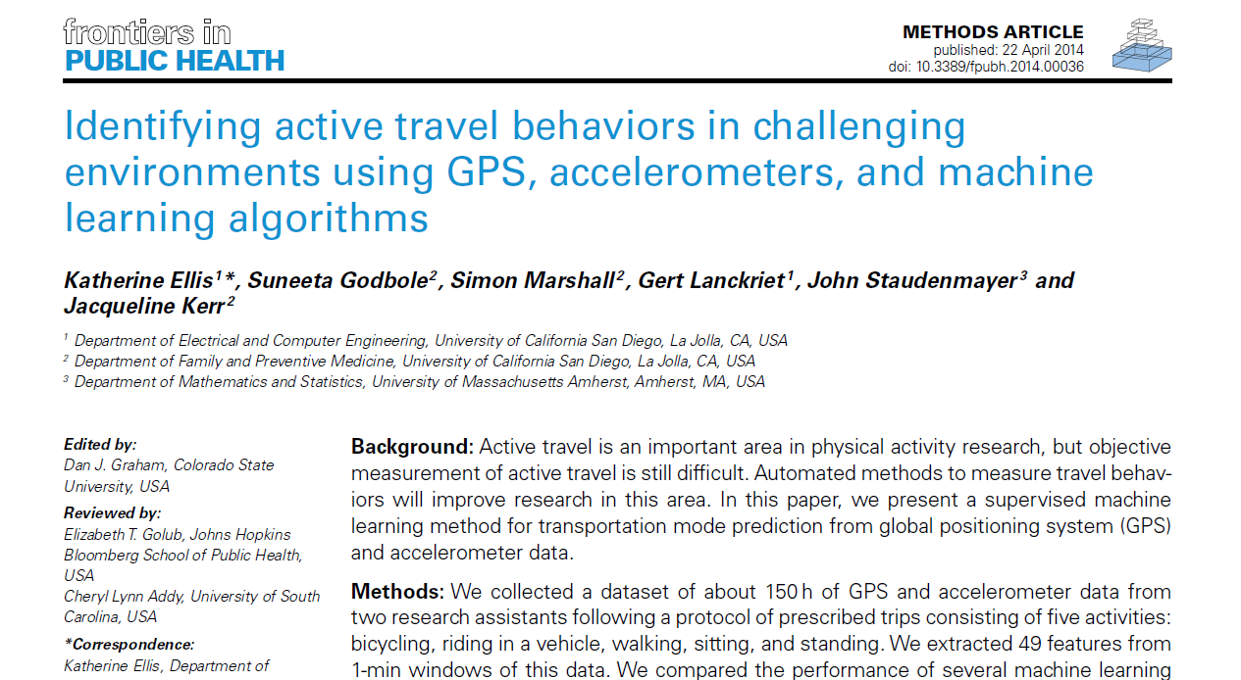
The random forest algorithm achieved 89.8% cross-validated accuracy on this
dataset. Adding the moving average filter to smooth output predictions increased the
cross-validated accuracy to 91.9%.

